Slide 1
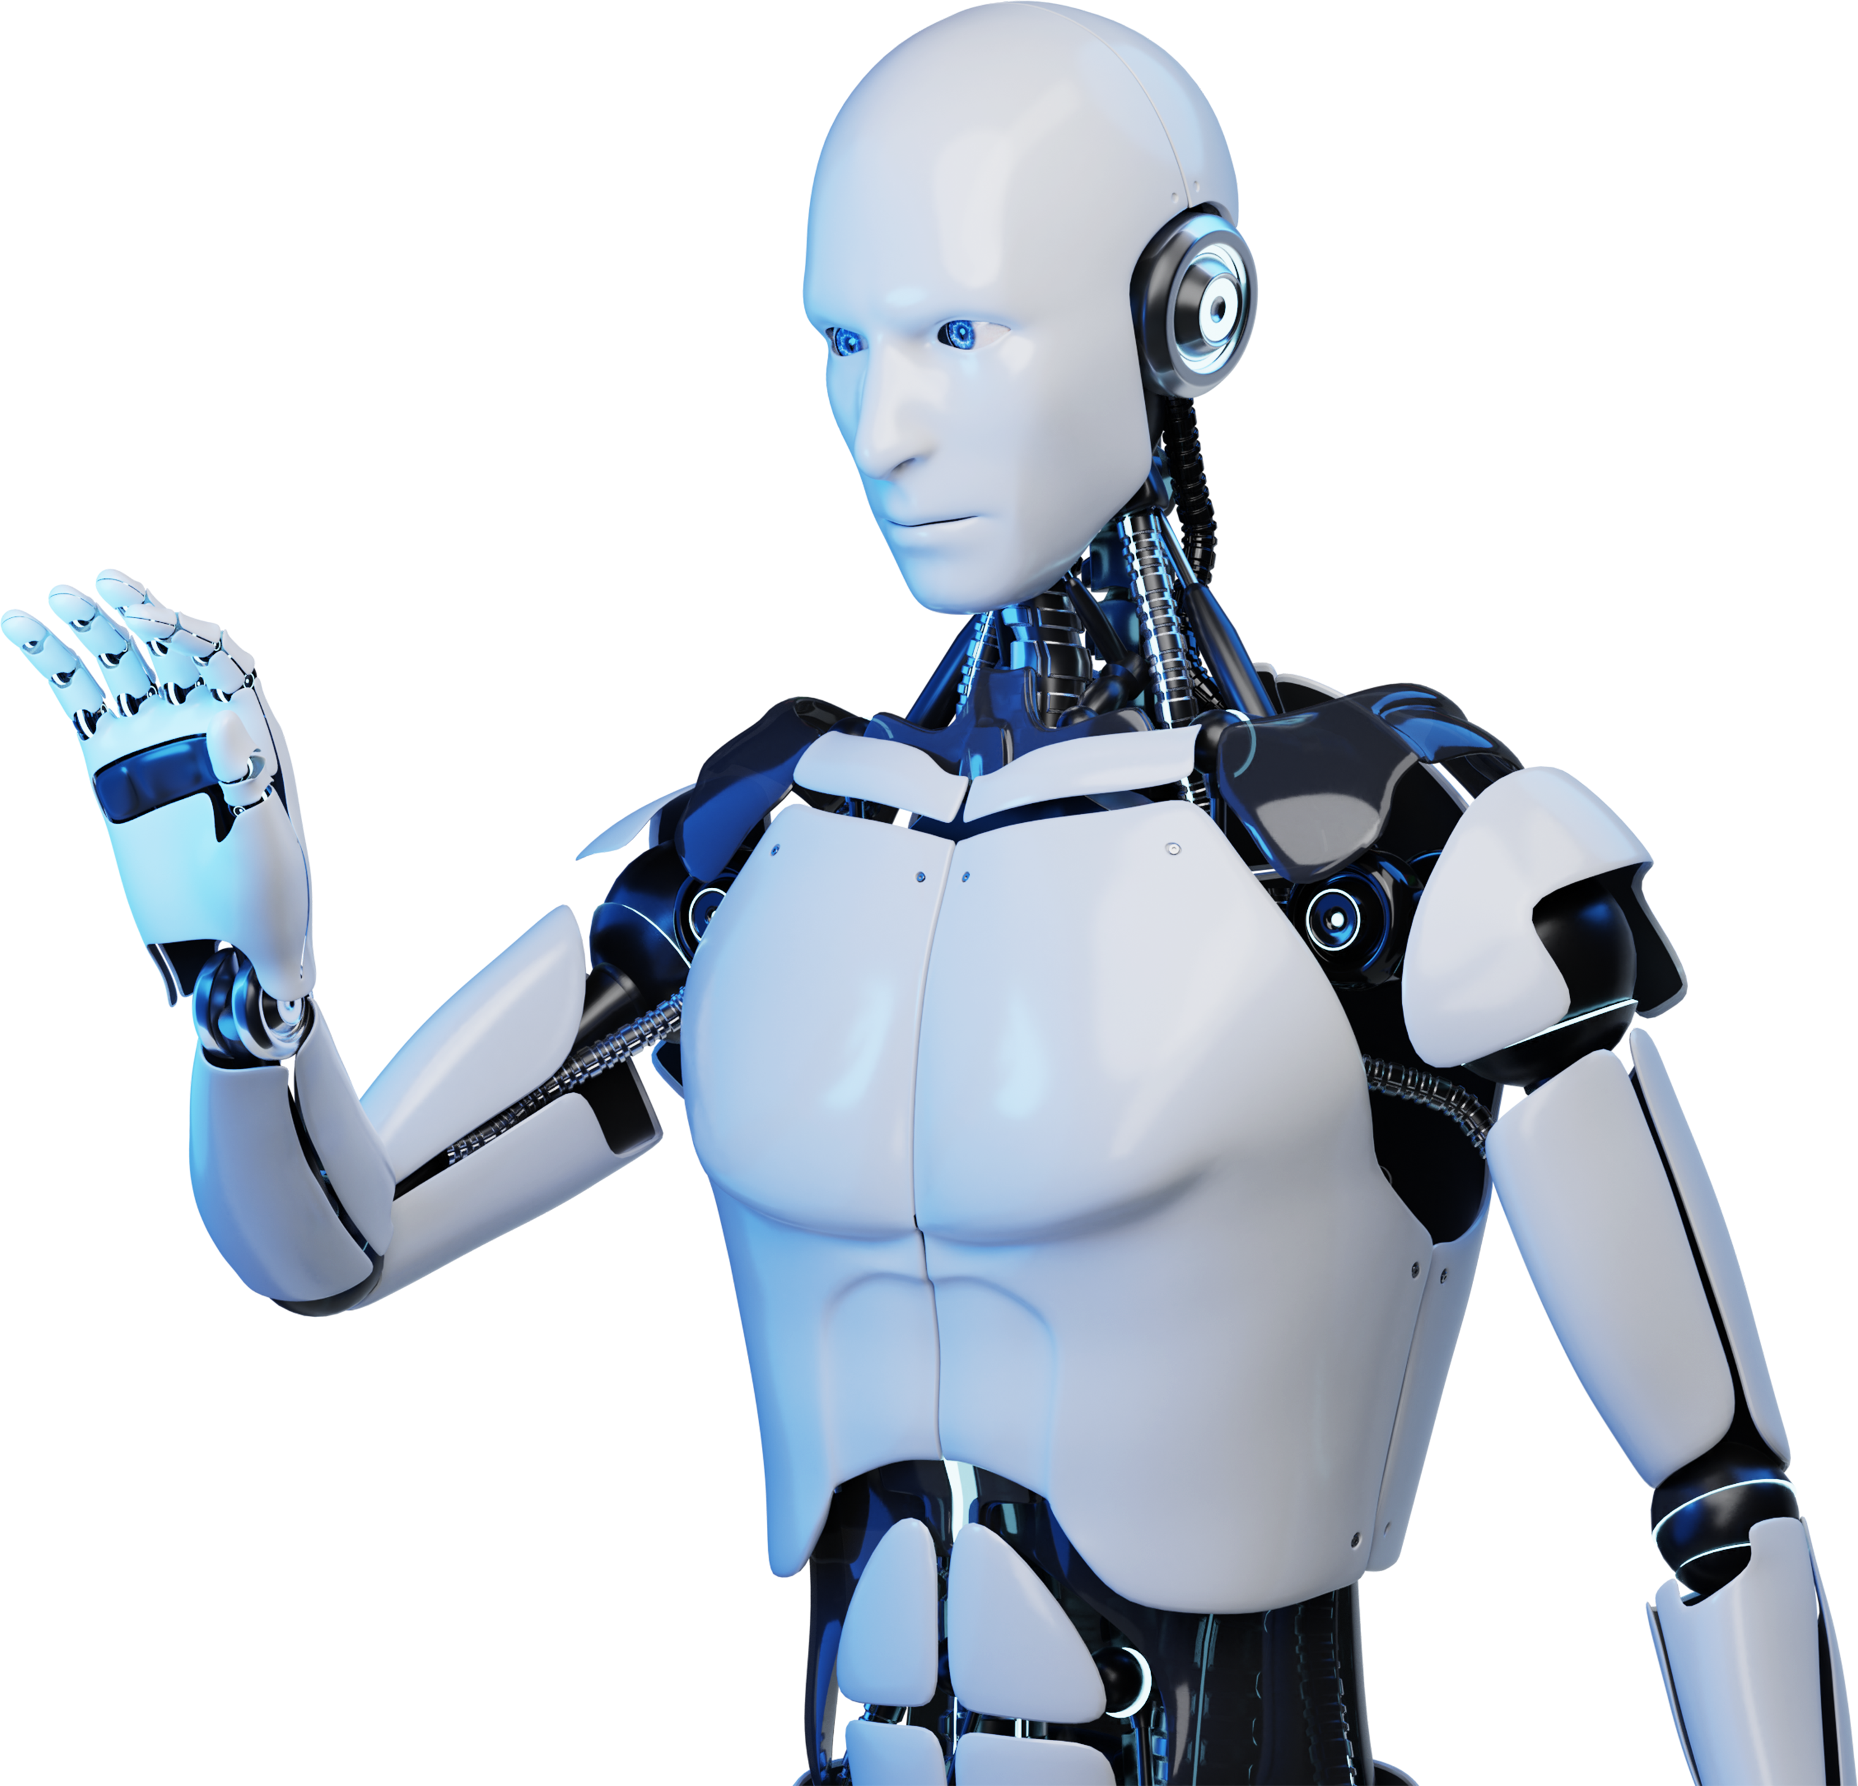
Chatbot with Multiple PDF’s Using AI

Slide 2
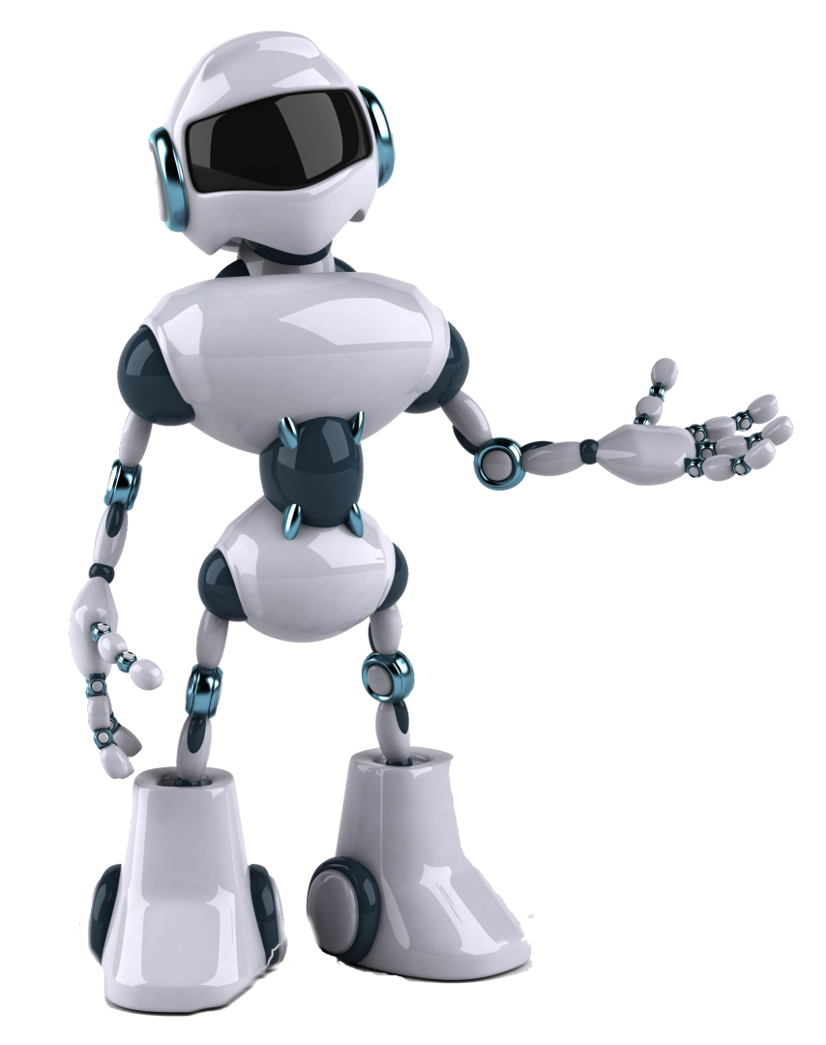
Introduction
The MultiPDF Chat App is a Python application that allows you to chat with multiple PDF documents.
Powered by OpenAI and Hugging Face models.
It is designed to provide a seamless chat interface for querying information from multiple PDF documents.
Enabling users to ask questions and receive relevant answers from the PDF content.
The app will only respond to questions related to the loaded PDFs.

Slide 3

Purpose
The purpose of this project is to create a chatbot that can interact with users and provide answers from a collection of PDF documents.
The chatbot uses natural language processing and machine learning techniques to understand user queries and retrieve relevant information from the PDFs.
By incorporating OpenAI and Hugging Face models, the chatbot leverages powerful language models and embeddings to enhance its conversational abilities and improve the accuracy of responses.

Slide 4
Features
1
Multiple PDF Support: The chatbot supports uploading multiple PDF documents, allowing users to query information from a diverse range of sources.
2
Conversational Retrieval: The chatbot uses conversational retrieval techniques to provide relevant and context-aware responses to user queries.
3
Language Models: The project incorporates OpenAI and Hugging Face models for natural language understanding and generation, enabling the chatbot to engage in meaningful conversations.
4
PDF Text Extraction: The PDF documents are processed to extract the text content, which is used for indexing and retrieval.
5
Text Chunking: The extracted text is split into smaller chunks to improve the efficiency of retrieval and provide more precise answers.

Slide 5
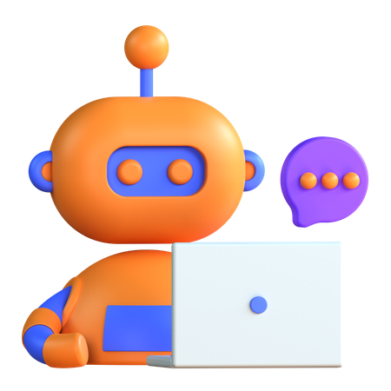
Import Libraries
Streamlit - Makes it easy to create and share custom web apps for machine learning and data science.
PdfReader - Extracting texts, images and other data from PDF documents.
ChatOpenAI - Allows you to send requests to OpenAI's models and receive information in return.
HuggingFaceHub - Allows you to interact with the Hugging Face Hub, a machine learning platform for creators and collaborators.
load_dotenv - allows you to load these environment variables into your Python project.
CharacterTextSplitter - A large text and splits it based on a specified chunk size.
FAISS – Efficient similarity search and clustering of dense vectors.

Slide 6
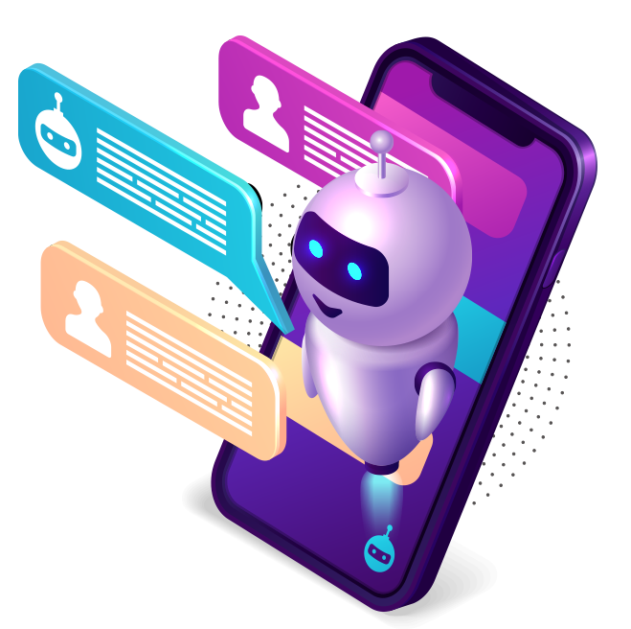
Usage
Upload PDF documents:
Use the sidebar in the application to upload one or more PDF files.
Ask questions:
In the main chat interface, enter your questions related to the content of the uploaded PDFs.
Receive answers:
The chatbot will generate responses based on the information extracted from the PDFs.

Slide 7
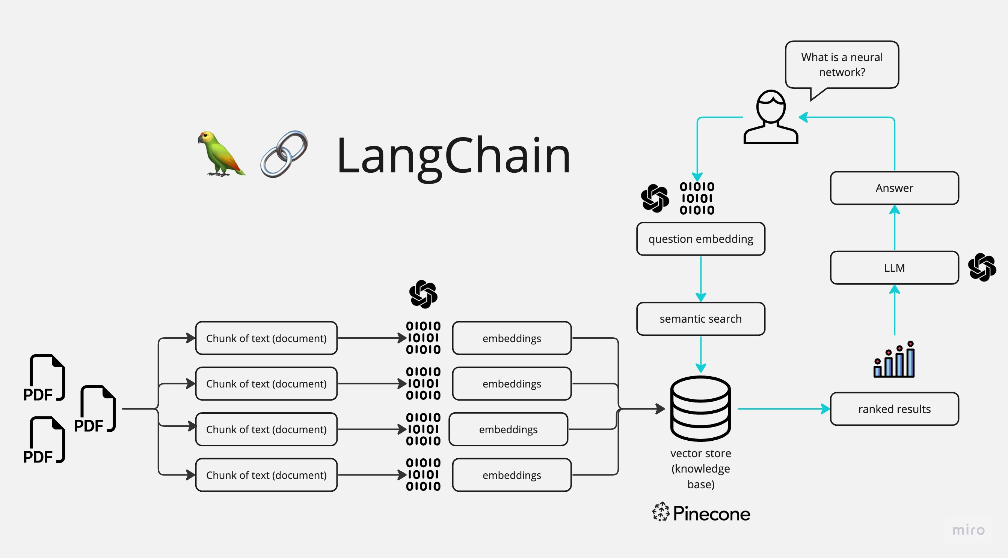

Slide 8
Applications
Educational Platforms
Chatbots integrated with PDFs can provide interactive learning experiences for students.
Customer Support
Offering in-depth product manuals or FAQs through PDFs enhances customer self-service.
Healthcare Information
Securely deliver medical documents or important healthcare information to patients.

Slide 9
Integrate Vector Database for storing embeddings.
Support for additional document formats, such as Word documents or web pages.
Integration of more advanced language models and embeddings.
Improved error handling and user feedback.
Future Enhancements
Enhanced user interface and customization options.

Slide 10

THANK YOU…

